Slide 1
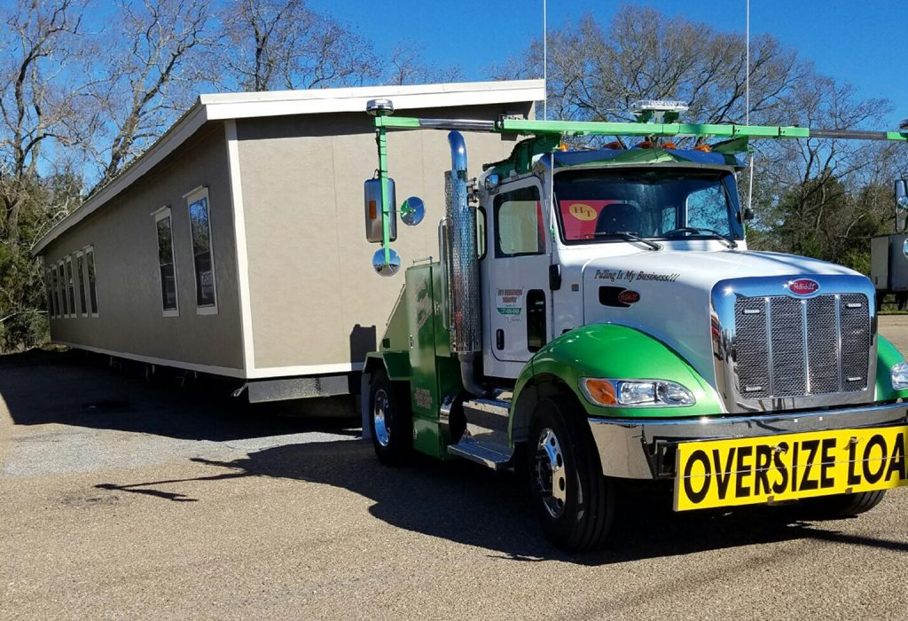
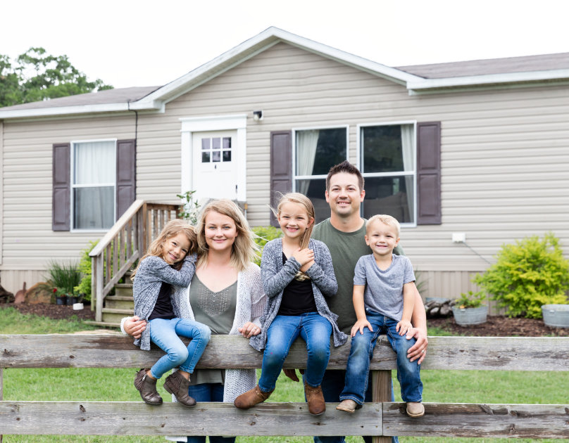
Donate Your Unwanted Mobile Home,
Get Free Removal plus a Tax Deduction
While helping a Deserving Family
We partner with Banyan Mobile Home Removal, a 501(c)(3) non-profit to help our clients. By donating your old mobile home to Banyan, you save $3000 to $5000 or more in removal/demo charges and get a tax deduction* for the value of the home.
Banyan sells your home at far below market value to a deserving family and provides interest-free financing, if needed. So, you are not only helping yourself, you are also helping a family in need in your local area need get a home of their own.
To donate your unwanted mobile home, go to BanyanMobileHomeRemoval.org
or call 866-739-5481!
*Check with your tax professional

